Slide 1


TAPS Student Assessment Experience Survey
Spring 2014
Academic Enhancement Department

Slide 2

The assessment survey sample
100 University of Roehampton students
64% local undergraduate students, 15% international undergraduate students, 11% local postgraduate students and 10% international postgraduate students
50% are 17-21 years old, 42% 22-30 years old and 8% over 30 years old.

Slide 3
Assessment formats in use
88% of students have plenty of experience in essay-writing, 50% in group tasks and 43% in giving presentations
63% have not tried making a podcast, 62% have not made a video and 52% have not participated in a symposium/student led discussion
42% have never heard of patchwork texts, 19% of e-portfolios and 10% of building a wiki/website

Slide 4
What forms of assessment do students want to try?
blog (20%)
student conference (20%)
symposium/ discussion led by students (17%)
DVD/video (16%),
podcast/audio recording (13%)
What forms of assessment do students NOT want to try?
wiki/website (31%)
DVD/video (25%)
audio/podcast (21%)
recital/performance (19%)
blog (13%)

Slide 5
What the students told us…

Slide 6
Better advice and guidelines
“Please give us clearer guidelines of expectations.”
“I was not confident as to whether my work was what was expected. Clearer outlines were needed.”
“I struggle with creative tasks, particularly when there is very little guidance on expectations.”

Slide 7
Affective issues as a learner
“Although it was a really difficult assignment, the results were also the most rewarding. Just because I found it hard doesn't mean it wasn't worthwhile.”
“Production under immediate, time- and resource-limited pressure is something I do not handle well.”

Slide 8
Timing of assessments?
“I think too many assessments are squeezed into two semesters; I have nothing at all in my summer term.”
“It's hard as you have to find information to put on the website, but also have to learn how to make a website!!!!”
“More possibilities to hand in work before essays are due”

Slide 9
Employability
“Remember there is a real world outside of the bubble of university, assessment should be about key skills.”
“There may be some worthwhile theory to be consider, but essays do not show how good a teacher someone will be.”
“I just really want to learn how to build a website, they can be really useful in promoting work etc.”

Slide 10
Grading scheme
“The grading system is confusing, with some teachers the highest result a student can get is 70% and with others it's 80% or 95%.”
“Looking at similar pieces online of work is really useful, and using them to stimulate our own ideas”
“The grading system isn't clear- for ages I didn't know how to meet my overall grade after I had done badly on some essays”

Slide 11
Range of choices
“Teachers should try to vary the assessment formats, not always writing based.”
“Assessments should be much more engaging. ..there should be more freedom.”
“It doesn’t matter how we are assessed, if it has something to do with the topic, it makes us learn more about the topics that really fascinate us.”

Slide 12

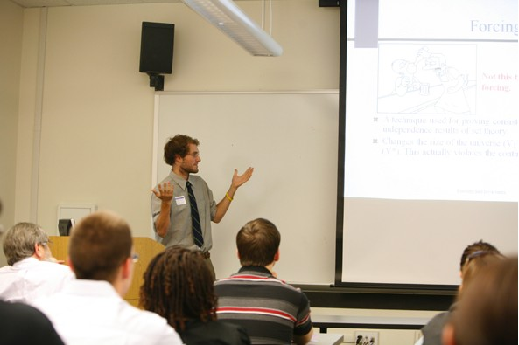
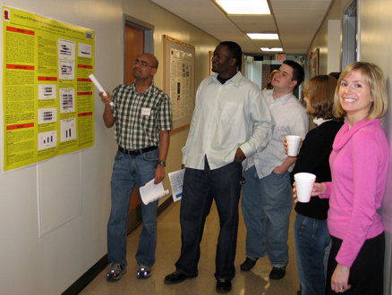
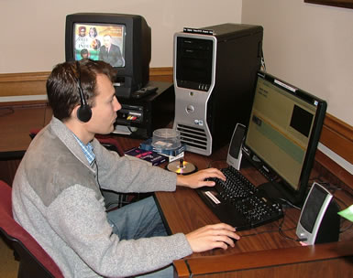



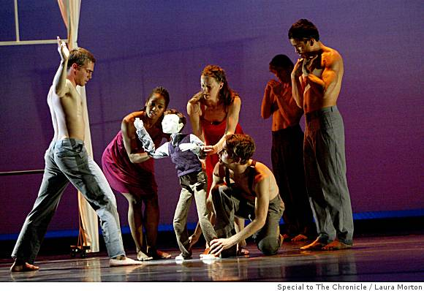
Discussion: What do you think?
What would students on your course say?
How can we improve our assessment practices?

Slide 13
Formative or Summative Assessments?
Reflective: Internally defined criteria/ goals | Prescriptive: Externally imposed standards
Diagnostic: Identify areas for improvement & development | Judgmental: Arrive at an overall grade / score
Flexible: Adjust as problems are clarified | Fixed: To reward success, punish failure
Absolute: Strive for ideal outcomes | Comparative: Divide better from worse
Cooperative: Learn from each other, develop academic skills | Individual effort: Student solely responsible for achievement

Slide 14
Summary of Differences
Dimension of Difference | Formative assessment | Summative
Timing | Throughout the course | End of course
Focus of measurement | Process-Oriented | Product-Oriented
Relationship between faculty and student | Reflective | Prescriptive
Findings / uses | Diagnostic | Judgmental
Modifiability of criteria | Flexible | Fixed
Standards of Measurement | Absolute, individual | Comparative
Purpose | Cooperative, developmental | Competitive

Slide 15
Five Assessment Principles
(after Thomas Angelo & Patricia Cross 1993)
To improve their teaching, faculty must define learning outcomes and accurately measure their attainment
To improve their learning, students must learn how to use feedback to assess their own progress ( self-assessment or peer assessment).
The best assessment derives from teachers’ questions about their own teaching ( what are my students learning?)
Systematic assessment can be an intellectually challenging source of faculty satisfaction
Assessment provides an impetus for active student involvement, a proven “best practice”.

Slide 16

Thanks for participating!
g.bohane@roehampton.ac.uk
b.middlemas@roehampton.ac.uk

