Slide 1

STUDENT WELLBEING SERVICES

Slide 2


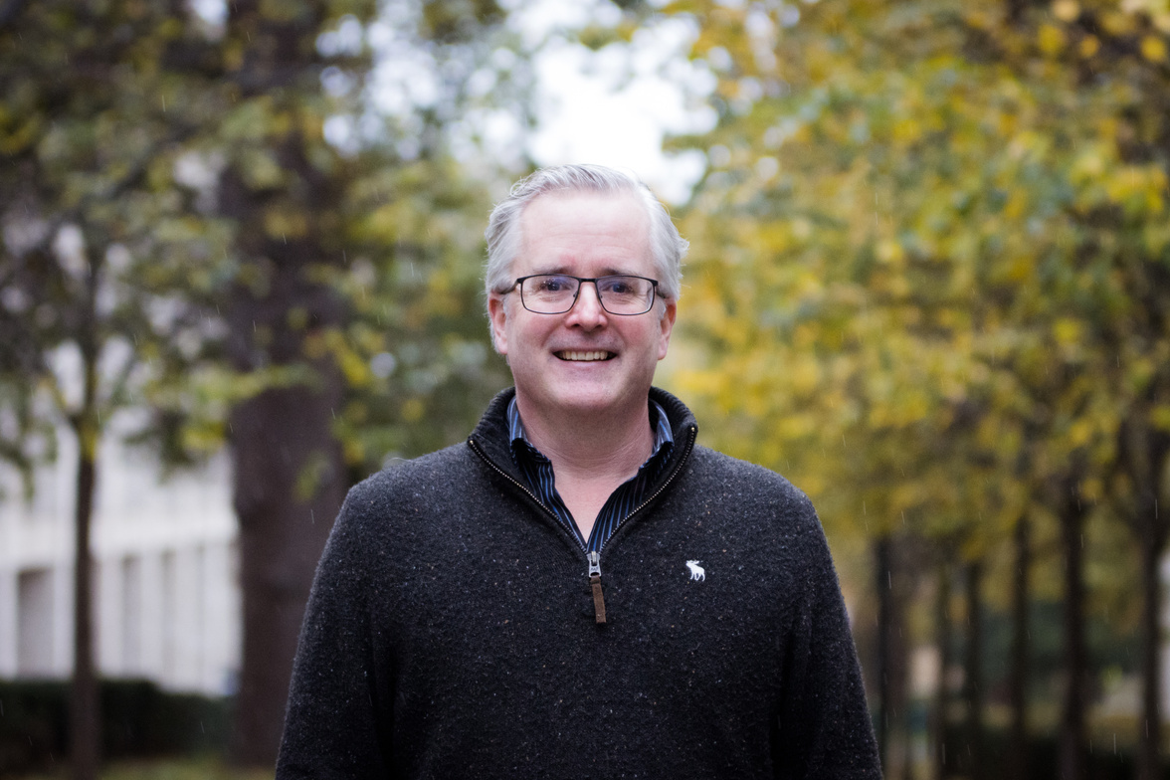
MEET THE WELLBEING OFFICERS
Based in each of our four Colleges, our Student Wellbeing Officers are friendly, supportive staff who can help with guidance on emotional support resources, and direct students to internal and external teams or services that can help address any wellbeing-related issues students are going through.
Jo
Digby (AHSS & SETEC students and students in Digby accommodation)
Rosanna
Digby (Nursing & Healthcare students) / Froebel (Education students and students in Froebel accommodation)
Colin
Southlands – Faculty of Business and Law and students in Southlands accommodation
Annie
Lead Student Wellbeing Officer
(interim)
Oli
Whitelands (Psychology and Life Science students and students living in Whitelands accommodation)
3

Slide 3



What we offer - SWO Service
A confidential service where students can discuss any issues or concerns that are affecting their wellbeing.
Signpost and refer to other internal and external services that may be able to offer further support.
30-minute full appointments with their wellbeing officer
15-minute Quick Query appointments available 48h in advance

Slide 4


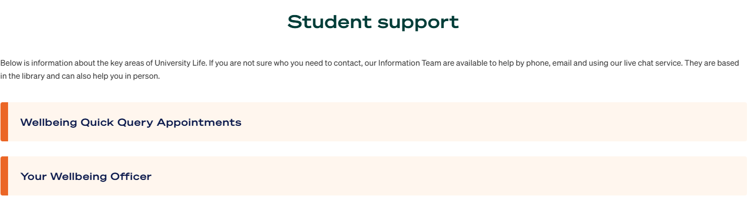

Your Student Wellbeing Officer is assigned to your campus accommodation, or (if you do not live on campus) the College in which you study
Digby Stuart
DigbyWellbeing@roehampton.ac.uk
Froebel
FroebelWellbeing@roehampton.ac.uk
Southlands
SouthlandsWellbeing@roehampton.ac.uk
Whitelands
WhitelandsWellbeing@roehampton.ac.uk
Wellbeing (general enquiries)
Wellbeing@roehampton.ac.uk
6

Slide 5





Additional Wellbeing Support
Our Counselling Service
Free access to Solution-Focused Counselling Sessions or Short-Term Counselling of up to 6 sessions.
In person or online
Mental Health Advisors
Experts on Mental Health issues who provide a short-term service, usually offering between 3-6 sessions, but may differ on a case-by-case basis.

Slide 6
Sexual Violence Liaison Officers Service
As Sexual Violence Liaison Officers (SVLOs), we are qualified specialist staff who provide support to students who have experienced sexual violence at any time in their lives.
How can I access this support?
Book to speak with an SVLO here for a one-hour confidential chat.
If you have a question, you can also contact the team by email at SVLO@roehampton.ac.uk
What happens after contacting the SVLO service?
An SVLO will contact students with some questions to establish how they can best support but will not ask the student to describe what has happened in detail, and there is no obligation to engage in continued support.
Sexual Misconduct - Report + Support - University of Roehampton

Slide 7
Bystander Intervention Team
Responsible for reinforcing the university’s zero tolerance stance on harassment, abuse and misconduct.
The team is formed of trained students, who are present at late-night events to support the Roehampton community through:
providing pastoral support
proactively intervening in problematic situations
supporting disclosures of sexual violence.
Works alongside the security team and bar staff to ensure a safe environment for everyone.
If you would like more information on the Bystander Intervention Team please contact Olwen.ottaway@roehampton.ac.uk.

Slide 8
