Slide 1


10:00 – 10:30am | Arrival and Registration
10:30 – 11:30pm | Course Introduction Portrait Room
11:30am – 12:30pm | Campus Services: DBS, Wellbeing, Disabilities Teams (introduced and overseen by SoE academic)
11:30am – 12:30pm | Optional Campus Tours
12:30 – 1:30pm | Lunch Break
1:30 – 3:00pm | Talks with Tutors in Subject-specific Groups Subject-specific areas

Slide 2
Matthew Sossick Head of Initial Teacher education
matthew.sossick@roehampton.ac.uk
Ruth Seabrook Head of Secondary ITE
Ruth.Seabrook@Roehampton.ac.uk
Steve Abrams Head of Professional Studies
steve.abrams@roehampton.ac.uk
Sonia Cordones PGCE Programme Lead
Sonia.Cordones@Roehampton.ac.uk

Slide 3
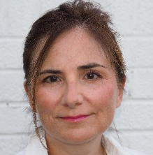
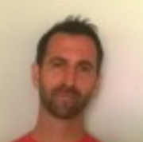

Who are we?
Ruth Seabrook – Head of Secondary ITE Ruth.Seabrook@roehampton.ac.uk
Sonia Cordones – Programme Leader
Steve Abrams– Head of Professional Studies – & Science
Tamara Bucan – Programme Administrator
Subject Tutors – see over

Slide 4
Subject Leads:
SUBJECT SUBJECT LEAD PHONE/E-MAIL (all @roehampton.ac.uk)
Art and Design Sally Dussek 020 8392 3871 sally.dussek
Computing Miles Berry 020 8392 3241 m.berry
Business Studies and Econ Rob.Buck N/A rob.buck
Dance Kelly McClelland N/A kelly.mcclelland
Design and Technology Catherine Stoner 020 8392 4411 catherine.stoner
Drama Rebecca Thompson 020 8392 5028 rebecca.thompson
English Mari Cruice 020 8392 3281 mari.cruice
Geography Rachael Butcher N/A rachael.butcher
History Ali Messer 020 8392 3106 thomas.pike
Mathematics Nick Langford 020 8392 3859 atif.jaleel
Modern Foreign Language Sonia Cordones/Nick Power 020 8392 3000 sonia.cordones /nicholas.power
Music Kate Potts-Lovegrove N/A kate.potts-Lovegrove/bella.urquhart
PE Lorraine Robins Kent N/A lorraine.robins-kent
Psychology Alex Knight N/A alex.night
Religious Education Simon Hughes 020 8392 3248 simon.hughes
Science (Bio) Steve Abrams 020 8392 3016 steve.abrams
Science (Physics/Chem.) Nicklas Lindstrom 020 8392 3087 nicklas.lindstrom
Social Sciences Tomislav N/A Tomislav.maric

Slide 5

We value a Froebelian approach to teacher education with whole child development at the core of our philosophy
Respectful: We respect each other and build positive relationships with our pupils and colleagues. We celebrate diversity and create an inclusive community.
Reflective: We reflect on our practice, connecting academic literature, research, and school experience. We strive to continually improve our pedagogy.
Resilient: We support each other and seek to grow from our challenges. We strive to realise our potential and to thrive together.
Resourceful: We work hard, and we are creative, imaginative, and curious. We keep learning.
Our Ambition is to:
Prepare our students for their early career induction; to inspire them to continue to learn and develop professionally.
Develop subject specific pedagogical content knowledge and an understanding of the what, how and why of teaching in different contexts; meeting the ECF and going beyond it.
Create research-informed curricula that meet the diverse needs of pupils in our partner schools.
Build a network of experts to mentor and support our students in our partner schools.
Assure quality using meticulous processes that support the highest possible standards.

Slide 6
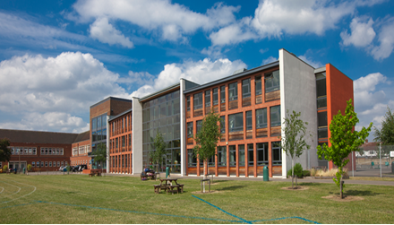
Course starts:
Enrolment day: 28th August
First Subject Day and induction: 3rd September (9 am to 4.30)
School placements:
Lead Partner and Apprentice students start earlier as directed by their lead school
Primary school Placements Mon/Tue 22nd and 23rd September
Uni-led students start in school on Thursday 25th September - you will find out schools in September.
Notes:
one of the largest providers of teacher education in the UK, working in close partnership with schools across London and beyond
a friendly and supportive university
the only campus-based university within London.

Slide 7

The pattern of the year 2025-26
The course starts on Thursday 28th August!!! So be ready!!
Induction Wednesday 3rd September at 9am to register
Up to 120 days in two different schools
University-led study every Wednesday and some Thursday's in September
Subject sessions/PS on Wednesdays
There will be some directed tasks completed remotely in the first few weeks
Numeracy task
Abyasa training Mon 8th Sept (so LP and App you won’t be in school)
Professional Studies: at Roehampton and in allocated PS hub schools

Slide 8
How it all comes together
Professional Studies
Some school-based training (hubs)
PS sessions at UR
One assignment
Subject pedagogy
Subject sessions
Learning rounds
Two assignments
Two contrasting placements
Increasing timetable
Increasing independence
Increasing pupil progress
Evidence for QTS working with a trained mentor

Slide 9
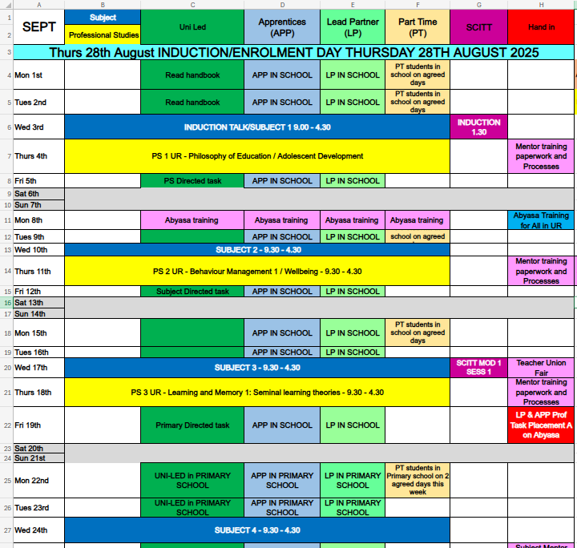
Calendar for 25-26

Slide 10
Conditions:
If you have outstanding conditions, you cannot enrol until these are all met so:
quals certificates - do not wait until Sept either send registered post or come in (Library)
Equivalency tests - do them NOW!
DOH/Suitability – do not delay.
DBS – you cannot go on placement without it.
You cannot fully enrol, get access to Moodle, email, Abyasa or your ID card without having met these!

Slide 11
DBS: DBS@roehampton.ac.uk
All students - If you already have a DBS and it is not on the update service, you must get a new one with Roehampton (Uni-Led) or your Lead Partner/APP.
Lead Partner/APP students you will do yours with your school and you MUST send a photo of page 1&2 to our DBS team.
Timescales – do it ASAP!

Slide 12
Student support
Study support and facilities: Library, Academic
Achievement Team
Tutor team
Financial support: scholarships, budgeting
advice from the SU
Hardship fund
Career support:
writing personal statements, how to apply, interview advice
Employment fairs
Health /wellbeing:
On-campus GP, mental health support, counselling, dyslexia and disabilities
Accommodation:
flat reps assigned to every flat, accommodation team to help with queries or concerns, close to facilities
International support:
Mentoring for students &
Liaison with schools
International team

Slide 13
Contacts for other help:
Admissions: Teachertraining@Roehampton.ac.uk
Health and Wellbeing: wellbeing@roehampton.ac.uk
Student Finance: StudentFinance@roehampton.ac.uk
Disabilities at Roehampton: Disabilities@roehampton.ac.uk
Please contact first the department concern – then your subject tutor for any concerns/worries
You can also contact me if you want advice or not had a response to other emails Sonia.Cordones@roehampton.ac.uk

Slide 14
10:00 – 10:30am | Arrival and Registration
10:30 – 11:30pm | Course Introduction Portrait Room
11:30am – 12:30pm | Campus Services: DBS, Wellbeing, Disabilities Teams (introduced and overseen by SoE academic)
11:30am – 12:30pm | Optional Campus Tours
12:30 – 1:30pm | Lunch Break
1:30 – 3:00pm | Talks with Tutors in Subject-specific Groups Subject-specific areas

Slide 15
Subject Leads:
SUBJECT SUBJECT LEAD PHONE/E-MAIL (all @roehampton.ac.uk)
Art and Design Sally Dussek 020 8392 3871 sally.dussek
Computing Miles Berry 020 8392 3241 m.berry
Business Studies and Econ Rob.Buck N/A rob.buck
Dance Kelly McClelland N/A kelly.mcclelland
Design and Technology Catherine Stoner 020 8392 4411 catherine.stoner
Drama Rebecca Thompson 020 8392 5028 rebecca.thompson
English Mari Cruice 020 8392 3281 mari.cruice
Geography Rachael Butcher N/A rachael.butcher
History Ali Messer 020 8392 3106 thomas.pike
Mathematics Nick Langford 020 8392 3859 atif.jaleel
Modern Foreign Language Sonia Cordones/Nick Power 020 8392 3000 sonia.cordones /nicholas.power
Music Kate Potts-Lovegrove N/A kate.potts-Lovegrove/bella.urquhart
PE Lorraine Robins Kent N/A lorraine.robins-kent
Psychology Alex Knight N/A alex.night
Religious Education Simon Hughes 020 8392 3248 simon.hughes
Science (Bio) Steve Abrams 020 8392 3016 steve.abrams
Science (Physics/Chem.) Nicklas Lindstrom 020 8392 3087 nicklas.lindstrom
Social Sciences Tomislav N/A Tomislav.maric

Slide 16







Communicate well!
Be organised!
Build resilience!
Remain Professional!
Remain calm!
Be curious!
Always!
MFL Mentee experience

Slide 17








What can I do to prepare?
Check/read subject info on welcome pages
Familiarise yourself with your Subject Curriculum
Addressing any subject knowledge gaps identified when completing the Subject Audit (complete any SKE asap)
Start Reading!!

