Slide 1
Science at Roehampton​
PGCE Core, Lead Partner & Apprenticeship routes ​
Vanessa Matthews
vanessa.matthews@roehampton.ac.uk
Nicola Treby
nicola.treby@roehampton.ac.uk

Slide 2
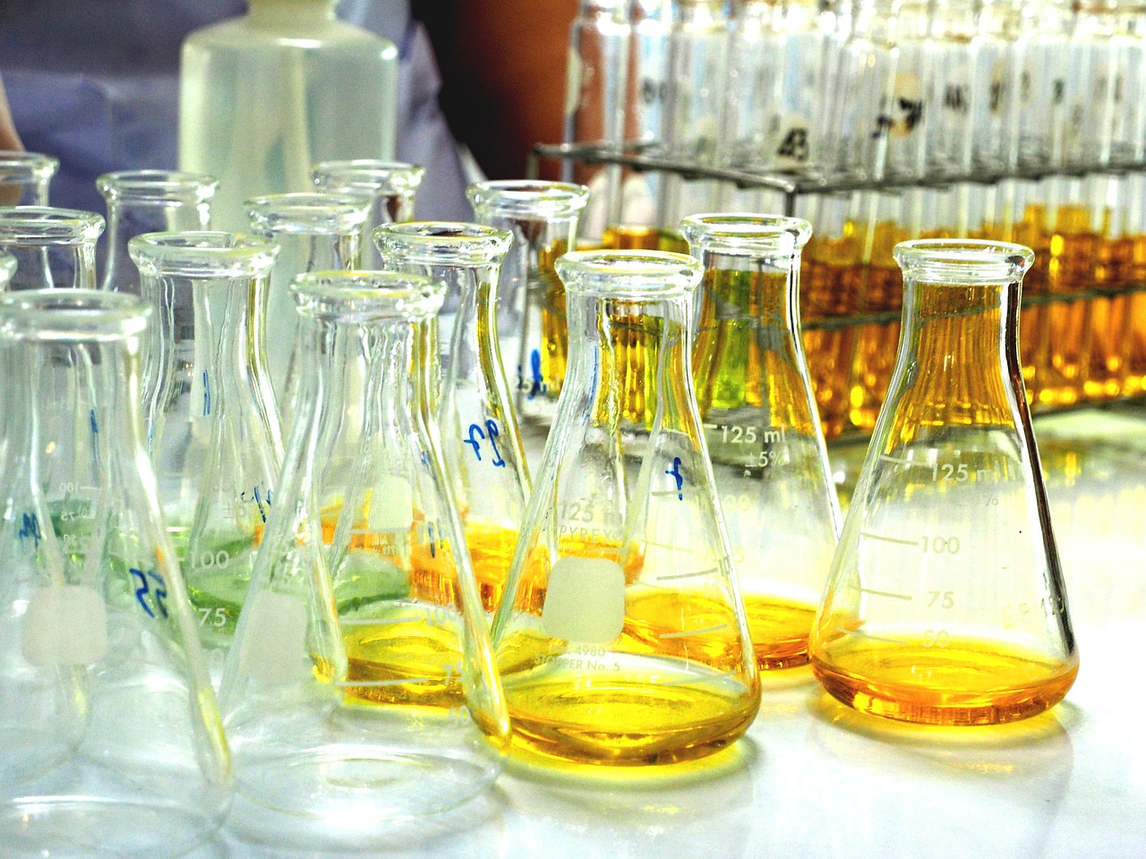
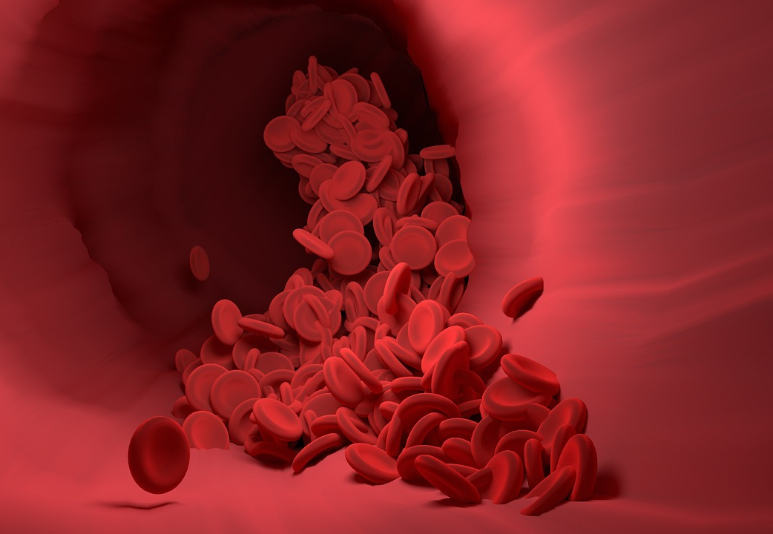

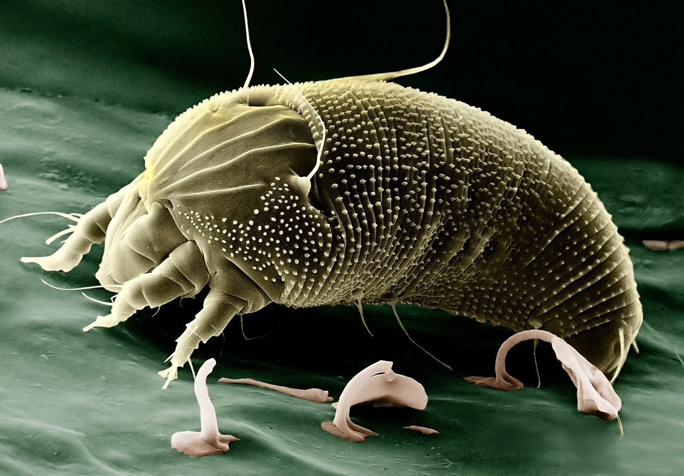
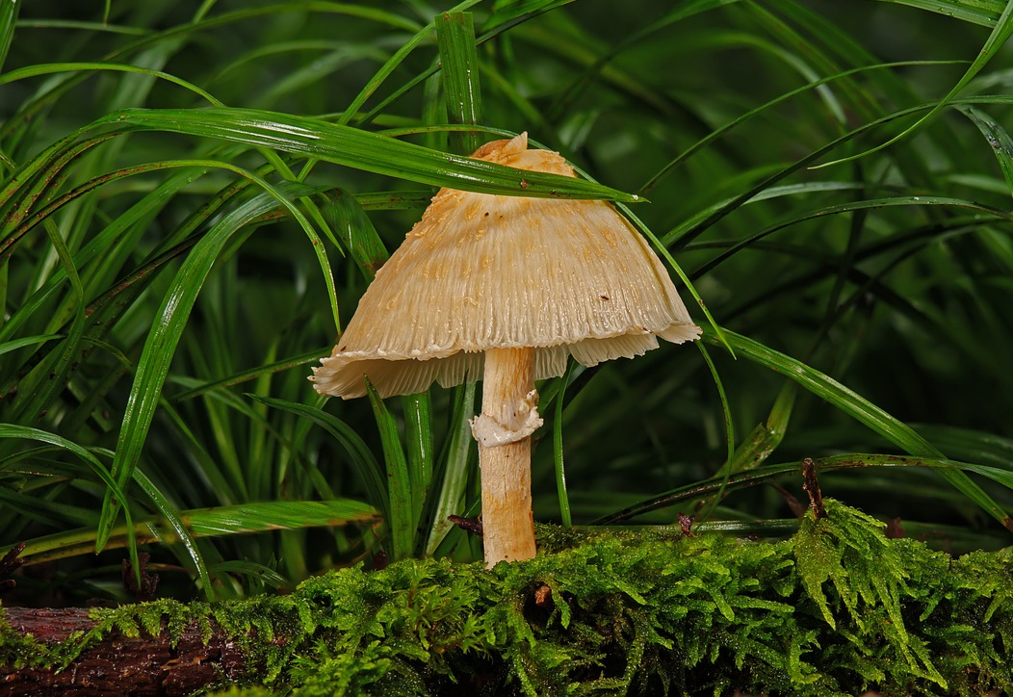
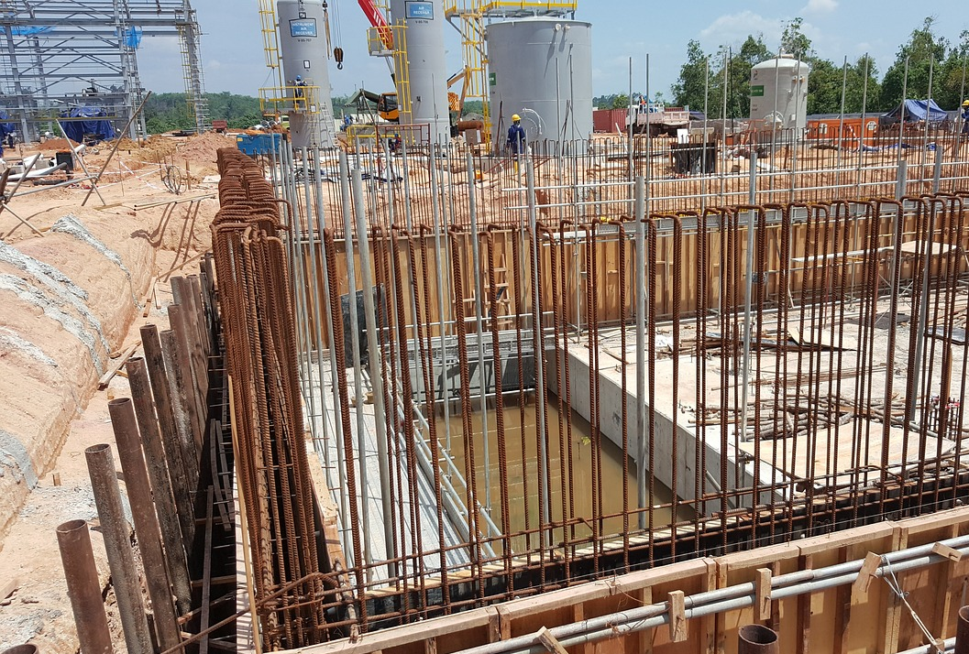
Understanding how the world works

Slide 3
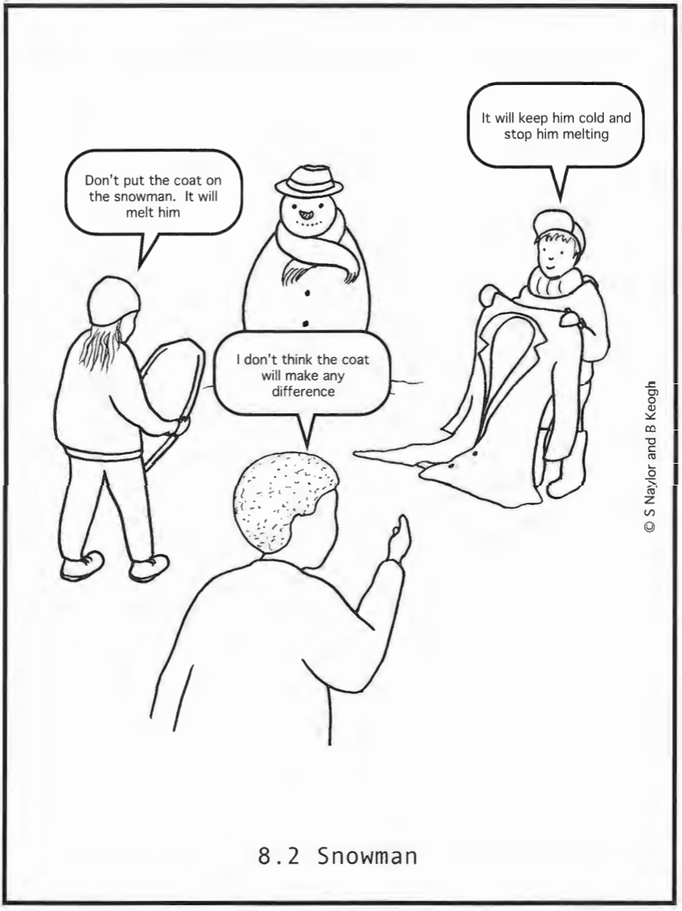
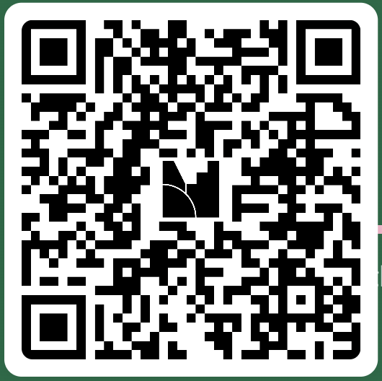
Who do you agree with?
B: It will keep him cold and stop him melting.
A: Don't put the coat on the snowman. It will melt him.
C: I don't think the coat will make any difference.

Slide 4
Concept cartoon - Snowman
Child A: So, I agree with the one, ‘Don’t put the coat on the snowman’ 'cause it will melt him, 'cause, the coat inside will probably have something that will...it will keep the snowman warm and then it will melt the snowman.
Child B: I agree with him.
Teacher: So, you agree, it'll melt if they put the coat on the snowman?
Child B: Yes!
Child C: Just like humans when they put a coat on, we all feel much warmer and nice. So, imagine putting a coat on a snowman, it will instantly melt in few minutes.
Child D: I think the same!
Child E: OK. I don’t think the coat will make any difference because everything will be just the same.

Slide 5

Have you completed the audit?
PGCE Primary Pre-Course Welcome Pages

Slide 6
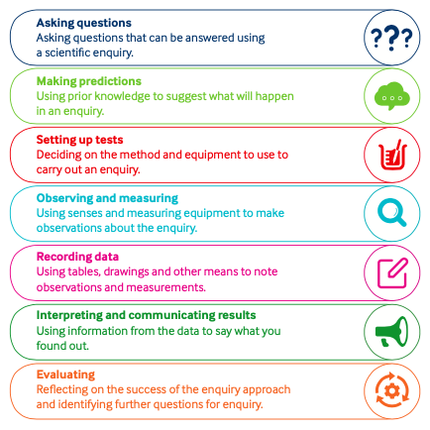
Enquiry
skills

Slide 7
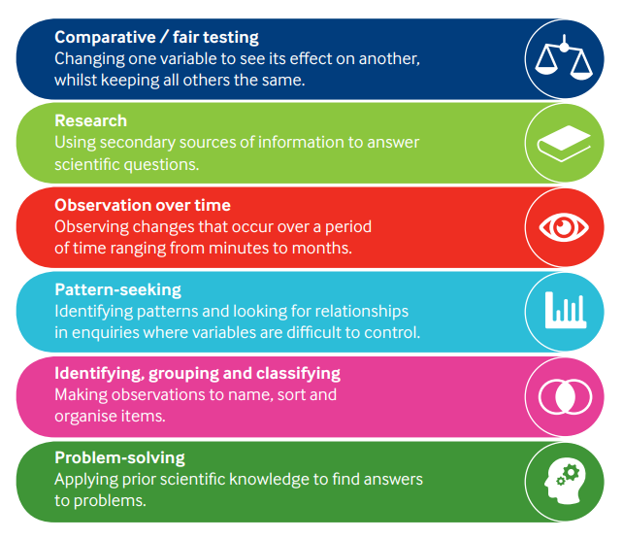
Enquiry
approaches

Slide 8





What will your course consist of?
1 |  | An introduction to primary science
2 |  | Working scientifically
3 |  | Planning and assessment in science
4 |  | Research informed practice in science
5 | Chemistry | Everyday materials and their uses
6 | Chemistry | Properties and changes of materials & States of matter
7 | Chemistry | Rocks & Evolution
8 | Physics | Light & Sound
9 | Physics | Forces and magnets

Slide 9

After Christmas
10 | Physics | Electricity
11 | Physics | Earth and space & Seasonal change
12 | Biology | Teaching science with sensitivity
13 | Biology | Plants
14 | Biology | Animals including humans (human body)
15 & 16 | Biology | Animals including humans (identifying and classifying) & Living things and their habitats
Sessions 15 & 16 will take place at the London Wetland Centre in Barnes.

Slide 10
What can you do over the summer to prepare?
Complete the subject knowledge audit if you haven’t already done so. We will provide you with materials to mark your audit in September.
Familiarise yourself with the national curriculum for KS1 and KS2.
Sign up to, and take a look around, the following websites:
STEM, Explorify, Primary Science Teaching Trust
4) You might like to look at our UoR science resource website.

Slide 11
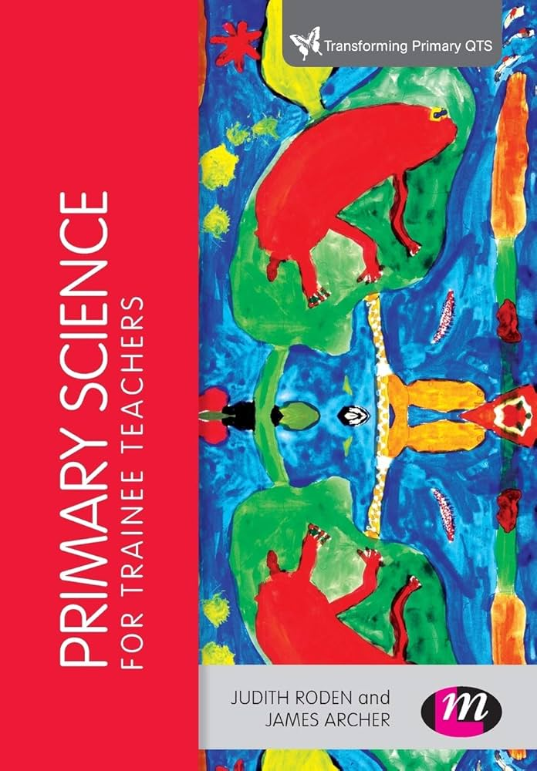
Key textbooks for subject knowledge – all the books you will need can be accessed via the physical and online library when you join the course in September.
Primary science for trainee teachers by
Judith Roden and James Archer abebooks.co.uk

