Slide 1


Mathematics at Roehampton
PGCE Core, LP and Apprentice Mathematics Module Lead: Lorraine Hartley
lorraine.hartley@roehampton.ac.uk

Slide 2

Aim and principles of effective professional development:
to engage in mathematics
and
mathematical thinking
The Advisory Committee on Mathematics Education: aims and principles of effective CPD (ACME, 2013, p.4)

Slide 3
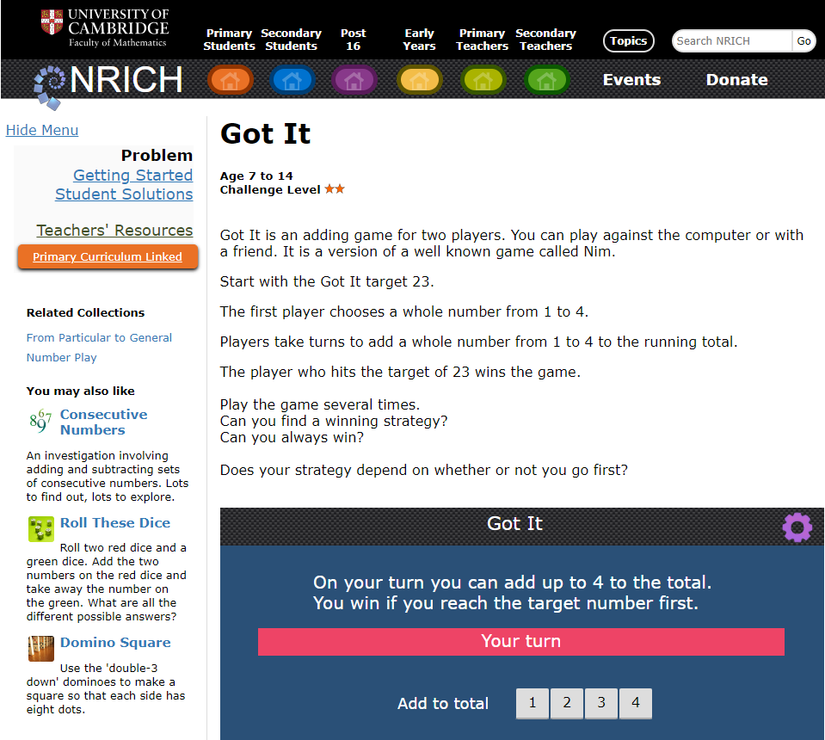
What do we mean by mathematical thinking?
https://nrich.maths.org/gotit/

Slide 4

Being Mathematical
Explaining, reasoning, justifying
Solving problems
Comparing approaches/being
flexible
Using mathematical language
Noticing
Pattern spotting
Making conjecture
Generalising and proving

Slide 5
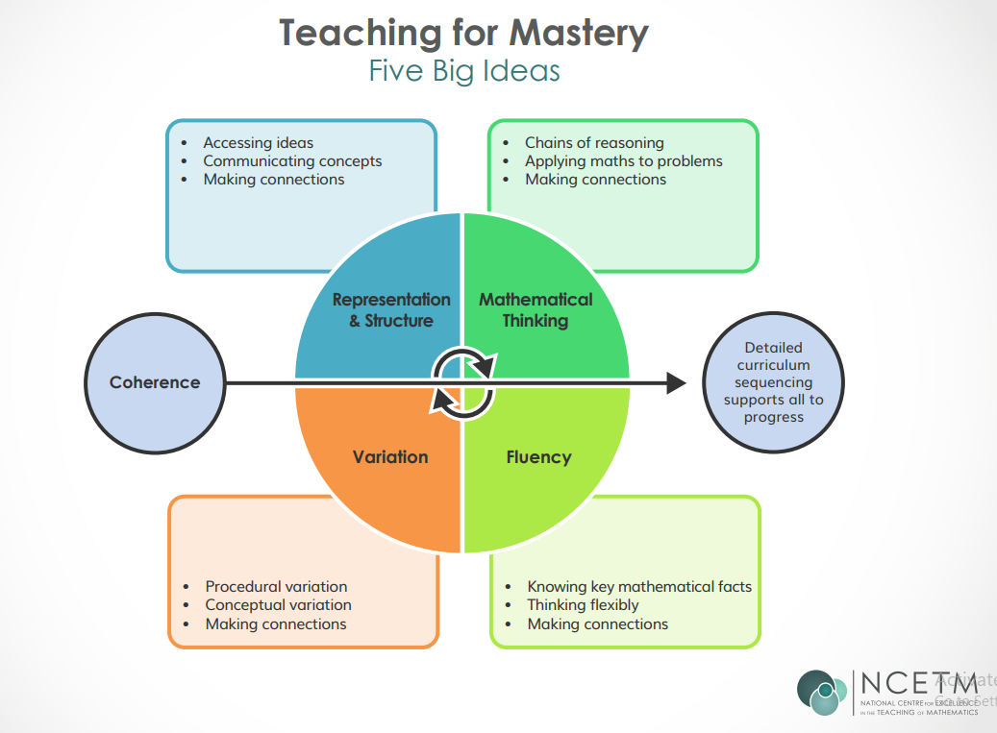

Slide 6
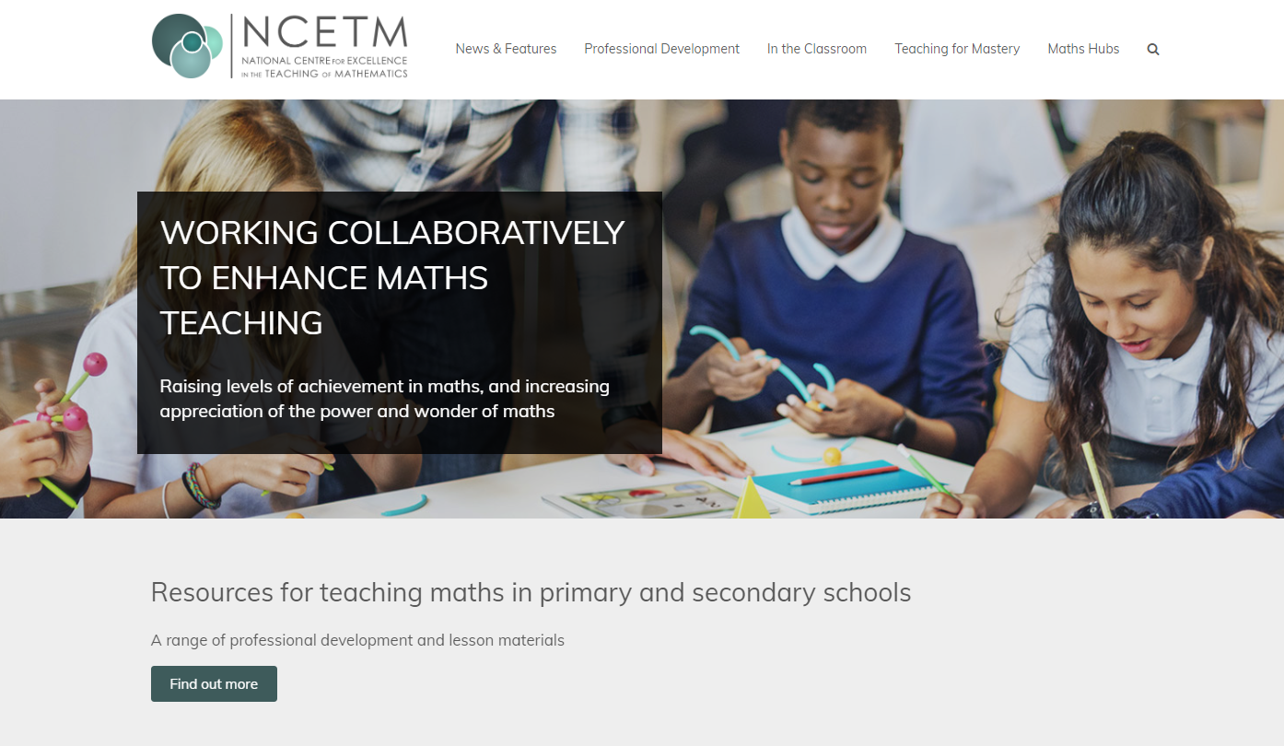

NCETM

Slide 7
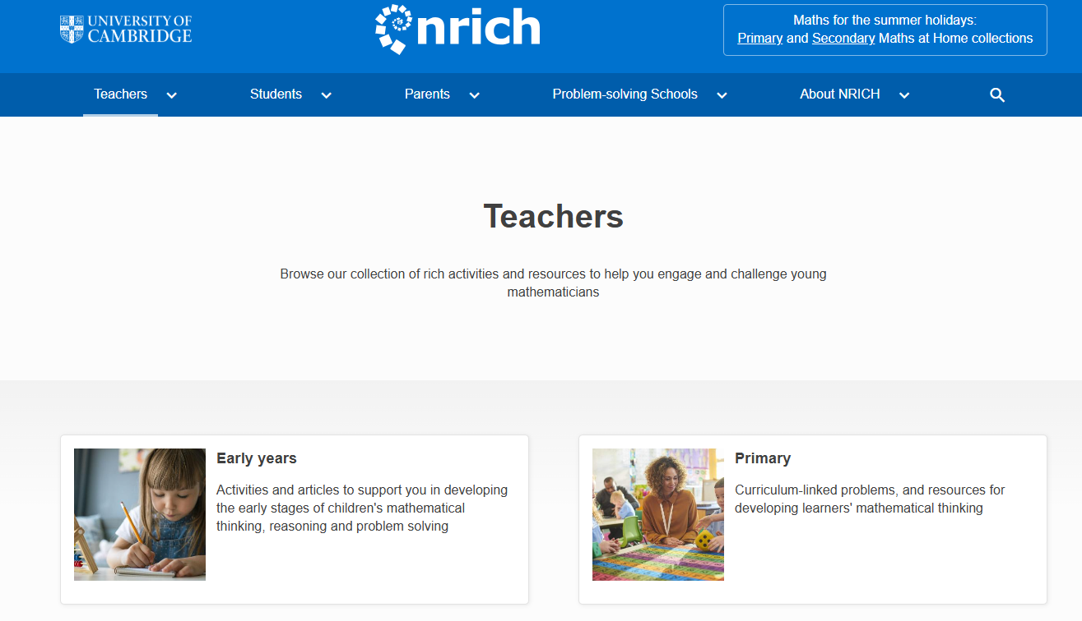

Slide 8
The aims and principles of effective professional development
to develop deep mathematical subject knowledge
The Advisory Committee on Mathematics Education:
aims and principles of effective CPD (ACME, 2013, p.4)

Slide 9
Subject Knowledge for Teaching
Deep understanding of fundamental concepts
Awareness of interconnectedness of mathematical concepts
Ball, D., Thames, M., and Phelps, G. (2008) Content Knowledge for Teaching: What Makes It Special? Journal of Teacher Education, Vol 59(5), pp. 389-407.

Slide 10
Subject Knowledge Audit
See Welcome Pages (pre course site)
Explanations and models in your audit answers are key
Start over the summer and complete once you are in university. You can and should get help!
Use Haylock (any edition) and other sources Nrich and NCETM (not BBC Bitesize), other people - see links on the audit for support with particular questions. Please read instructions carefully.

Slide 11
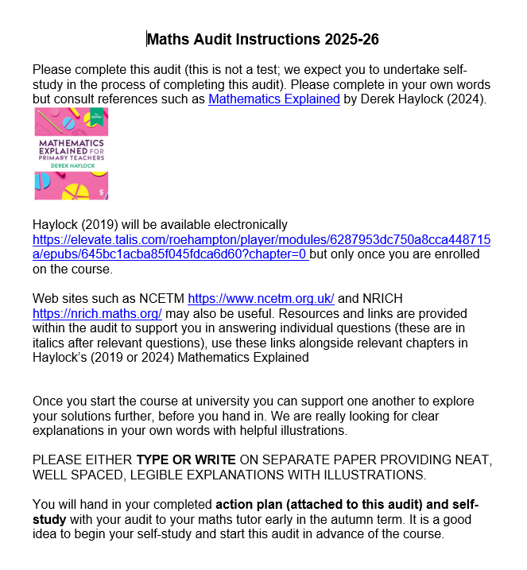

Slide 12
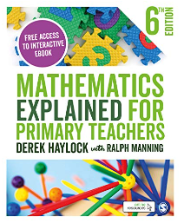
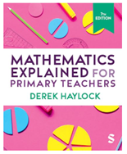
Essential Text

Slide 14
Preparation for Teaching Mathematics
NCETM http://www.ncetm.org.uk
NRICH http://nrich.maths.org
National Curriculum Mathematics Guidance (2021) https://www.gov.uk/government/publications/teaching-mathematics-in-primary-schools
Key Text
Haylock, D. and Manning R. (any edition) Mathematics Explained for Primary Teachers (5th edition), London: Sage Publications
https://roehamptonuniversity.on.worldcat.org/oclc/1053570022
If you need to do additional practice exercises:
Haylock, D. and Manning, R. (any edition) Student Workbook for Mathematics Explained for Primary, Teachers, London: Sage Publications

Slide 15
Roehampton and Mathematics
Resilience
being stuck is part of learning in mathematics
embrace challenge
don’t give up easily
learn from mistakes
Reflection
know your strengths and areas for development
Resourceful
make use of recommended resources
Respectful
respect the importance of developing your own subject knowledge and respect yourself for not knowing now but learning for future generations

