Slide 1


Introduction to English
Steph Laird
s.laird@roehampton.ac.uk

Slide 2
Du Iz Tak?

Slide 3
What is being said?

Slide 4
Elements of Language
Sound
Word
Sentence

Slide 5
Elements of Language
MEANING
(semantics)
https://www.youtube.com/watch?v=81CxsmxWvO4

Slide 6
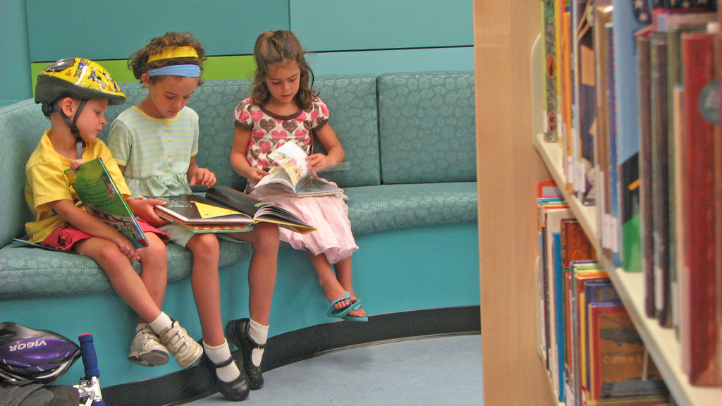
What is English?
What are your memories of English lessons in primary school?
‘English has a pre-eminent place in education and in society. A high-quality education in English will teach pupils to speak and write fluently so that they can communicate their ideas and emotions to others and through their reading and listening, others can communicate with them. Through reading in particular, pupils have a chance to develop culturally, emotionally, intellectually, socially and spiritually. Literature, especially, plays a key role in such development. Reading also enables pupils both to acquire knowledge and to build on what they already know. All the skills of language are essential to participating fully as a member of society; pupils, therefore, who do not learn to speak, read and write fluently and confidently are effectively disenfranchised.’
The national curriculum (2014) Purpose of Study English – key stages 1 and 2
This Photo by Unknown Author is licensed under CC BY-SA

Slide 7


Familiarise yourself with documentation
https://www.gov.uk/government/publications/early-years-foundation-stage-framework--2
https://www.gov.uk/government/publications/national-curriculum-in-england-primary-curriculum

Slide 8
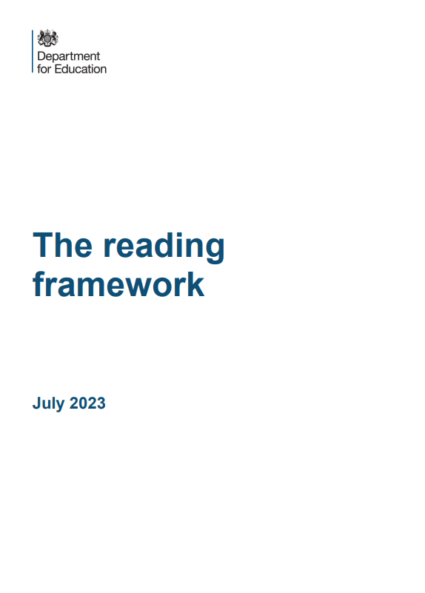
Early reading and ssp
Phonic knowledge
In order to teach reading effectively you will need to develop your subject knowledge about systematic synthetic phonics.
In order to prepare yourself for this important strand of subject knowledge:
Look up the following terms and make notes about them: systematic synthetic phonics, phoneme, grapheme, digraph, trigraph, adjacent consonants, blend, segment.
Understanding how early reading is taught is an important aspect of the course. Read The Reading Framework (DFE, 2023):
https://www.gov.uk/government/publications/the-reading-framework-teaching-the-foundations-of-literacy

Slide 9
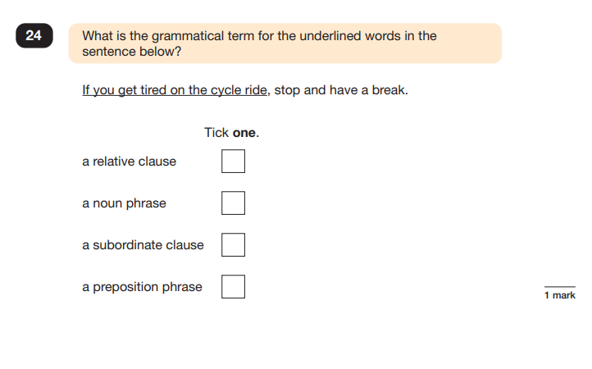
spaG – brush up on your grammar knowledge
Difference between phrase and clause – a clause includes a subject and a verb.
‘You’ and ‘get’ are subject and verb so cannot be a phrase.
A relative clause always starts with a relative pronoun - who or which or that.
A subordinate clause is one which doesn't have complete meaning on its own and relies on the main clause for its meaning. Therefore, this is a subordinate clause as the second part gives you the information required for the sentence to make sense. It starts with the subordinating conjunction ‘if’.
SPaG test 2024

Slide 10
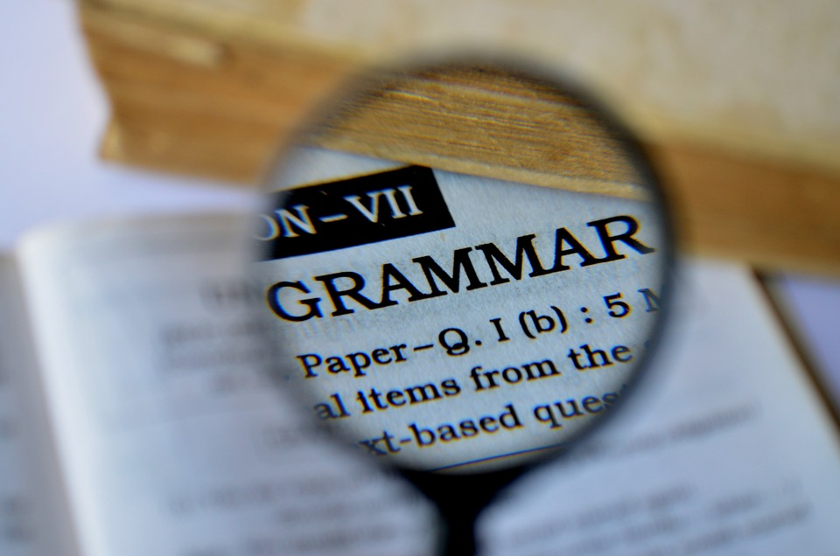
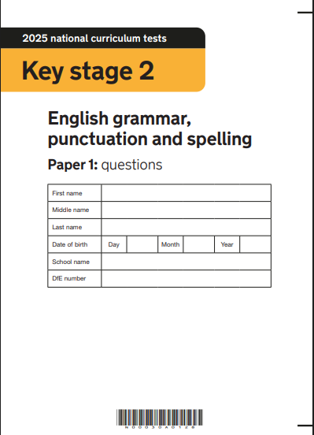
https://www.gov.uk/government/publications/key-stage-2-tests-2025-english-grammar-punctuation-and-spelling-test-materials

Slide 11
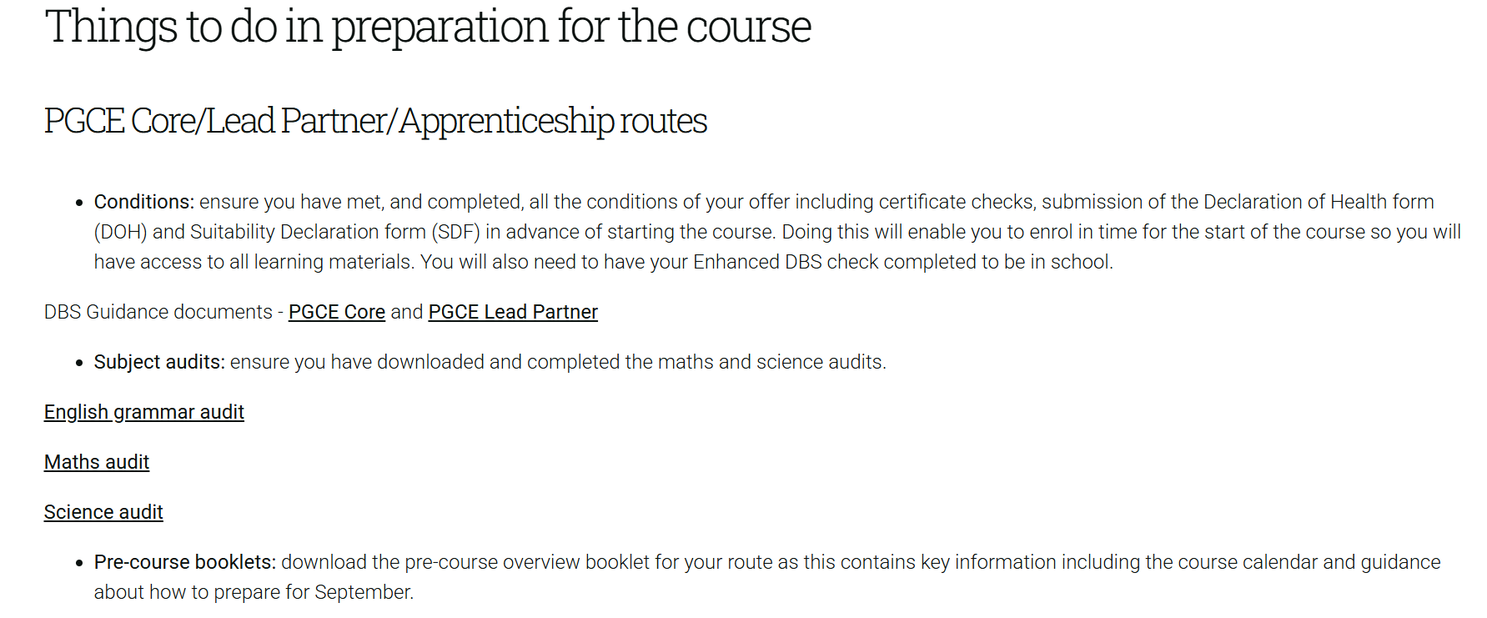
Have you completed the English grammar audit?
https://www.roehampton.ac.uk/study/academic-areas/education/pgce-offer-holder-page/pgce-primary/

Slide 12
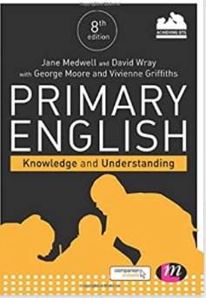
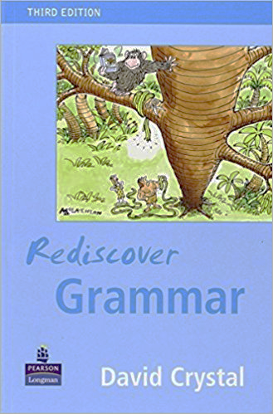
Finding resources to support your subject knowledge
Medwell, J. ad Wray, W. with Moore, G. and Griffiths, V. (2017) Primary English: Knowledge and Understanding (8th ed.). London: Sage
Crystal, D. (2004) Rediscover Grammar. London: Palgrave Longman

Slide 13
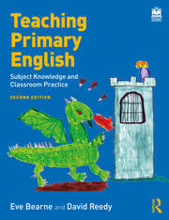
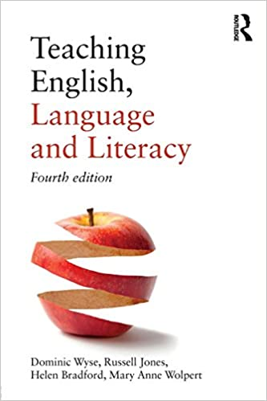
Teaching Primary English:
Subject Knowledge and Classroom Practice
Eve Bearne and David Reedy.
Routledge (2023)
Teaching English,
Language and Literacy
(4th Edn.) Dominic Wyse, Russell Jones, Helen Bradford, and Mary Anne Wolpert. Routledge (2018)
HE Level 6
HE Level 7
Both of these texts are available as eBooks
(available in September once you have enrolled)

Slide 14
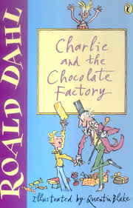
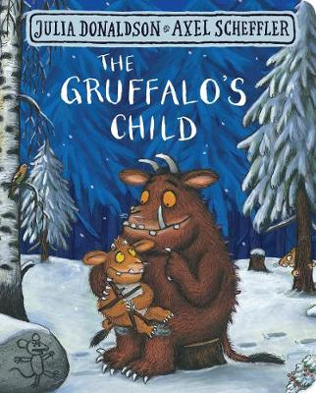
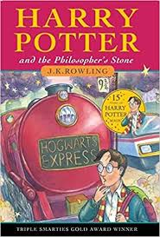



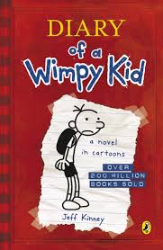
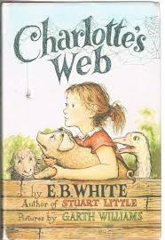


Look at the covers of these well-known children's books. Name the book title and the author.

Slide 15
The Gruffalo’s Child
Julia Donaldson
Harry Potter and the Philosopher’s Stone
J. K. Rowling
Wind in the Willows
Kenneth Grahame
Where the Wild Things Are
Maurice Sendak
Charlie and the Chocolate Factory
Roald Dahl
Elmer
David McKee
The Cat in the Hat
Dr Seuss
Diary of a Wimpy Kid
Jeff Kinney
Charlotte’s Web
E.B. White
The Tiger who came to Tea
Judith Kerr

Slide 16



https://www.thereaderteacher.com/
https://www.lovereading4kids.co.uk/blog/diverse-voices-childrens-books-that-celebrate-difference-6090
https://ukla.org/ukla-book-awards-2025-shortlist/

Slide 17
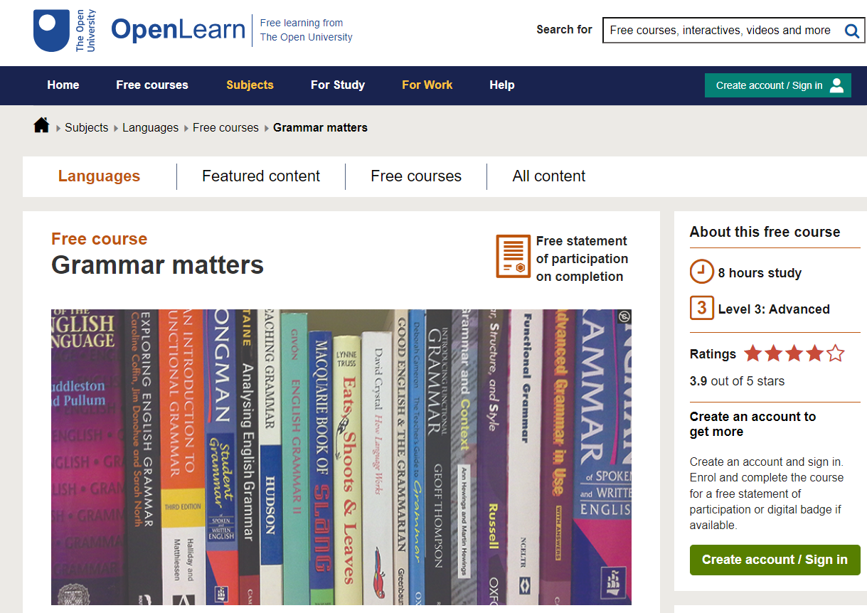

Free online courses
https://www.open.edu/openlearn/languages/grammar-matters/content-section-0?active-tab=description-tab
https://ourfp.org/

Slide 18
Preparation for English – refer to the pre-course booklet
Download and complete the grammar self-study audit
Enjoy reading and researching children’s books over the summer

