Slide 1
PGCE Primary
2025-2026
Welcome to our Taster Day!
We will start at 9.30am.

Slide 2

PGCE Primary
Overview of the day
From 9am – Arrival and registration
9.30 – Welcome and Introductions (Steph Laird)
9.45 – PGCE Core and PGCE Lead Partner/Apprenticeship Introductory talks (Steph Laird & Pablo Mayorga)
10.30 – Introduction to Professional Studies (Sarah Leonard)
10.50 – Introduction to English (Steph Laird)
11.10 – Break
11.40 – Introduction to Maths (Lorraine Hartley)
12.00 – Introduction to Science (Vanessa Matthews)
12.20 – Final questions
12.30 – Campus services – DBS, Wellbeing, Disabilities teams
12.45 - Optional campus tours available
~ Optional campus tours available ~
Welcome to the University of Roehampton

Slide 3

PGCE Primary
Aims of the sessions:
To introduce you to key people;​
To share information about the course structure and how to prepare for the start of the course;​
To find out about the Professional Studies and Core subject modules;​
To have the opportunity to pose any questions you may have.​
Welcome to the University of Roehampton

Slide 4
Routes into teaching
PGCE Core
PGCE Lead Partner
PGCE Apprenticeship

Slide 5
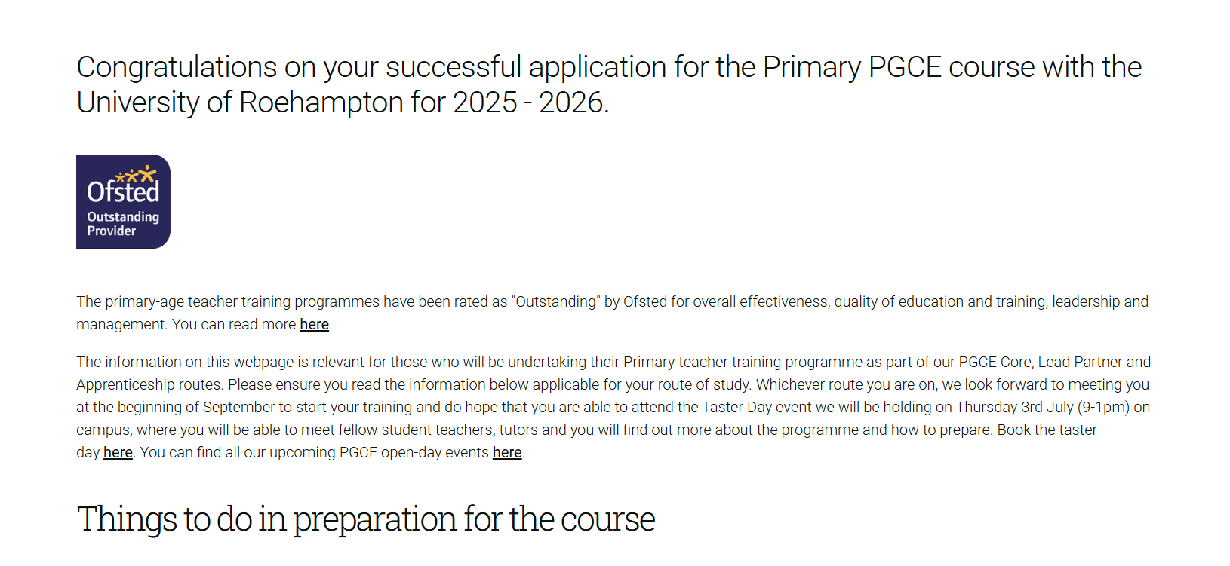

Pre-course information
https://www.roehampton.ac.uk/applying/offers/ite-at-roehampton/pgce-primary/
Pre-course Welcome Pages link – sent in email from the university

Slide 6
Things to do…
Conditions: ensure you have met, and completed, all the conditions of your offer including certificate checks, submission of the Declaration of Health form (DOH) and Suitability Declaration form (SDF) in advance of starting the course. Doing this will enable you to enrol in time for the start of the course so you will have access to all learning materials. You will also need to have your Enhanced DBS check completed to be in school.
DBS : ensure you look at the guidance on the Welcome Pages.
Welcome to the University of Roehampton

Slide 7
Things to do…
Ensure you read the information for the PGCE Core Primary route.
1 – Complete the subject audits (the subject leads will provide further information).
2 – Read the pre-course booklet and note the key calendar dates (download this).
3 – Engage in some readings from the pre-course booklet to prepare.
4 – Organise your observation school placement - see letter on the pre-course Welcome Pages. You will inform your group tutor of the school at induction.
5 – Ensure you have met all existing conditions.
6 – You will be sent online enrolment access over the summer.
Welcome to the University of Roehampton

Slide 8
Observation Days in September
Observation week school: you are required to find a school to do a week of focussed observation in from Monday 15th September to Friday 19th September inclusive. This forms part of your required number of days in school. Please use the letter from the Welcome Page to send to schools and follow the guidance within.
Email schools with a covering email and attach the letter for Head Teachers (on the Welcome Pages) – you need to arrange these asap.
Observation days task booklet will be provided during induction.
Welcome to the University of Roehampton

Slide 9
Enrolment Day: PGCE Primary - Core/Lead Partner/Apprentice - Thursday 28th August
Please attend the University on August 28th to complete your enrolment onto the course ready to start the following week.
Before you attend, please complete the online enrolment information which will be sent to you closer to your start day. This can only be done once all of your conditions have been met. Check your status of these on the DfE apply service and refer to DBS guidance on this page. It is important that you bring the following documents with you on that day to complete the enrolment process:
Identification – passport or driver’s licence.
Original exam certificates – your degree certificate and GCSE (or equivalent) for English, maths and science.
DBS certificate or evidence that you are on the update service.
You should attend at the following times:
Between 2 and 4pm

Slide 10
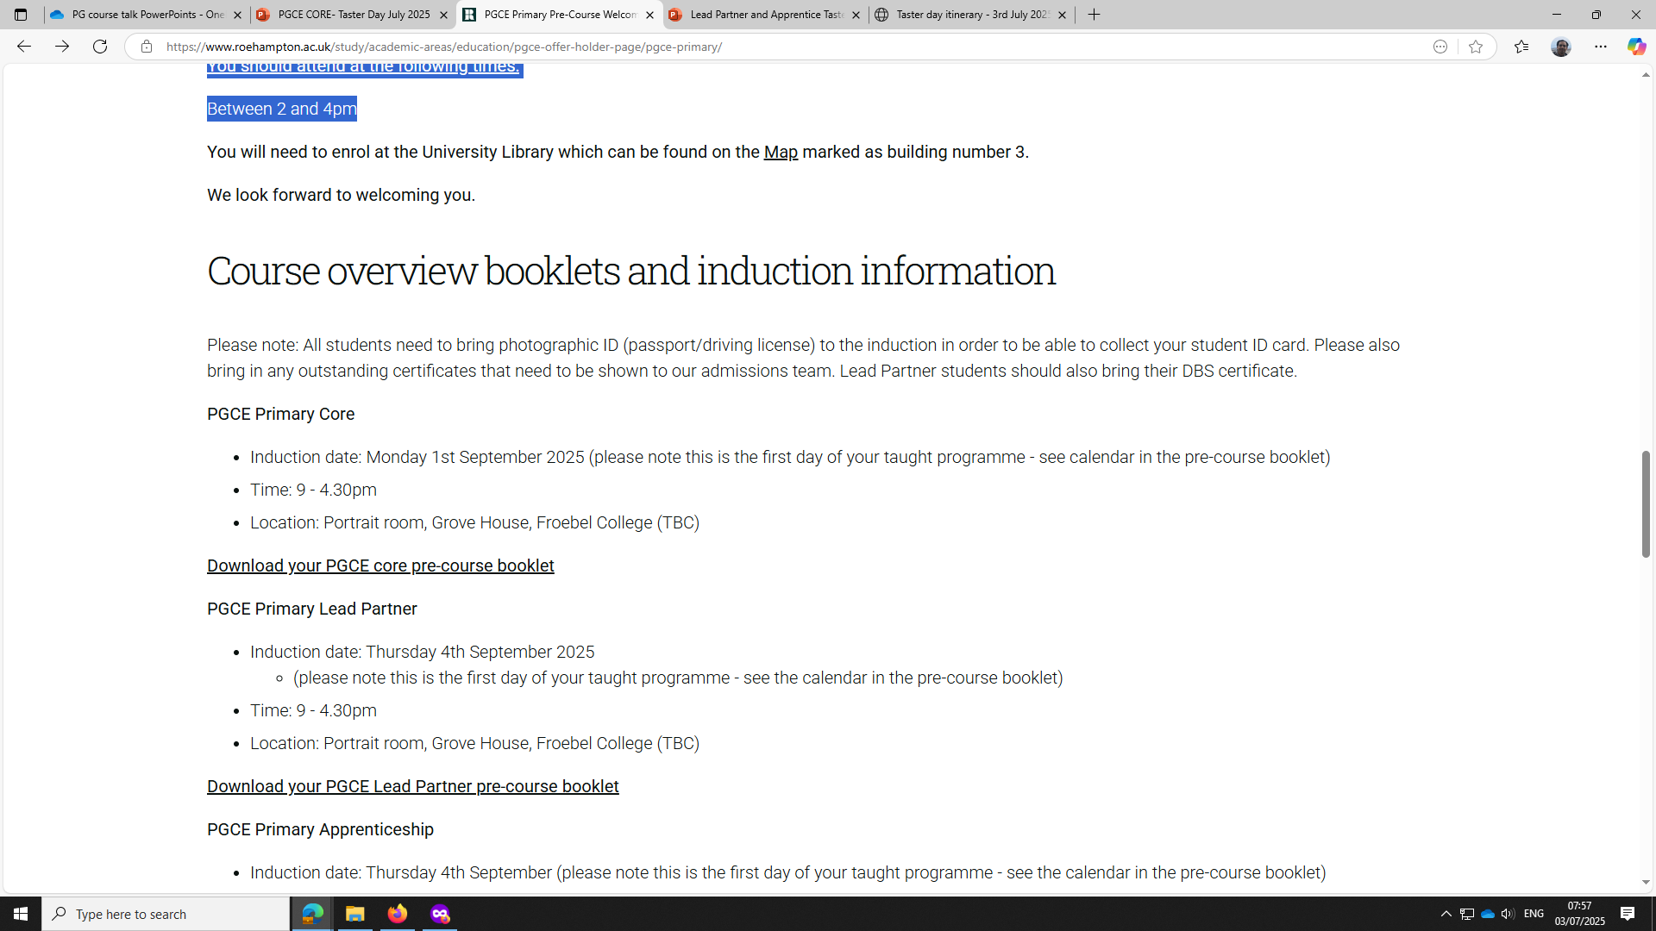
Induction Day – Monday 1st September
Welcome to the University of Roehampton

Slide 11
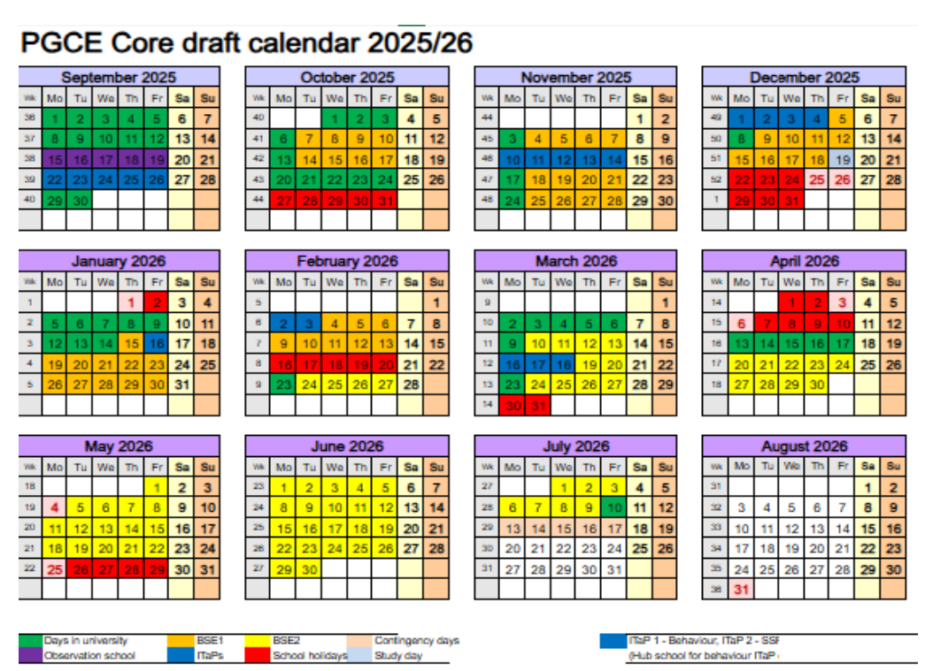
Course calendar in the PGCE Core pre-course booklet
N.B. 100% attendance is expected on the course.
The taught course is every day 9-4/5pm. Timetables will be provided at induction on 2nd September.
Welcome to the University of Roehampton

Slide 12
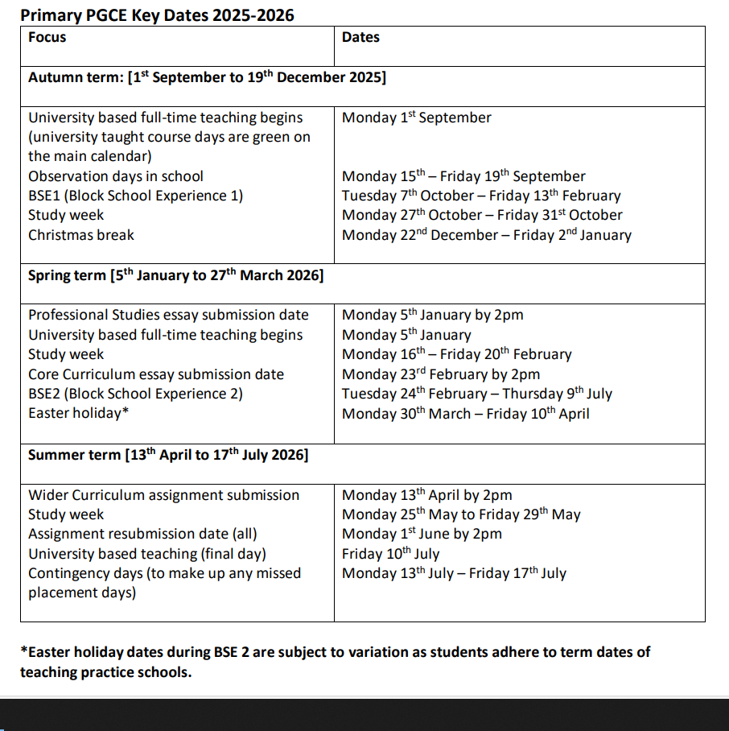

PGCE Primary
Key dates 2024 - 2025
Key dates for the programme are in the pre-course booklet. Note these in a diary!

Slide 13

PGCE Primary
What is the PGCE?
Initial Teacher Education programme for primary teachers of children aged 3-11 years.
PGCE (Postgraduate Certificate in Education) with 60 master’s-level credits (Level 7) and awarded Qualified Teacher Status (QTS) or PROGCE (Professional Graduate Certificate in Education) with 60 credits at Level 6 or above and Qualified Teacher Status (QTS).
The programme is a teaching qualification which aims to produce teachers who meet the Teachers’ Standards and also an internationally recognised academic qualification.
Welcome to the University of Roehampton

Slide 14



Academic writing guidance – see the pre-course Welcome Pages – Academic Writing guidance section for self-study materials to prepare.
https://www.roehampton.ac.uk/applying/offers/ite-at-roehampton/academic-writing-guidance/
PGCE Primary
Taught Modules
University Master’s Level Modules
Professional Studies
The Core Curriculum
The Wider Curriculum
Each assignment is 20 master’s level credits
Welcome to the University of Roehampton

Slide 15

PGCE Primary
Assessment
You will be assessed against the Areas of Professional Learning during your school placements in order to meet the Teacher’s Standards at the end of the programme: Professional Behaviours, Curriculum, Pedagogy, Assessment and Managing Behaviour = Qualified Teacher Status (QTS)
You will be assessed on Master’s criteria marking for your assignments – you will receive an assignment booklet at induction.

Slide 16

PGCE Primary
ITaPs - Intensive Training and Practice weeks
From academic year 2024/25 all ITT leading to Qualified Teacher Status (QTS) must incorporate a new set of Quality Requirements. As part of this, we will be introducing four ‘Intensive Training and Practice’ (ITaP) weeks which ‘should focus on specific, foundational, or pivotal areas of the ITT curriculum. It should also demonstrate and build the interplay between evidence-based theory and practice, engaging trainees in critical analysis, application of learning to classroom practice, and focused feedback on such practice,’ (DfE, Initial teacher training (ITT): criteria and supporting advice).
Focus on creating a positive classroom environment, SSP, scaffolding and questioning.

Slide 17
Assessed School Placements
Block School Experience 1 (BSE1) – 7th October – 13th February
Block School Experience 2 (BSE2) – 24t February – 9th July
Your placements are organised by our School Partnership Office (SPO) team and you will have received an email asking for you to complete information about your address (also a QuestBack survey for your age-phase preference for placements) etc. Please ensure you complete the information required asap and let us know if you have not yet received this email. You will be assigned a Roehampton Mentor to supervise your assessed placements.
Welcome to the University of Roehampton

Slide 18
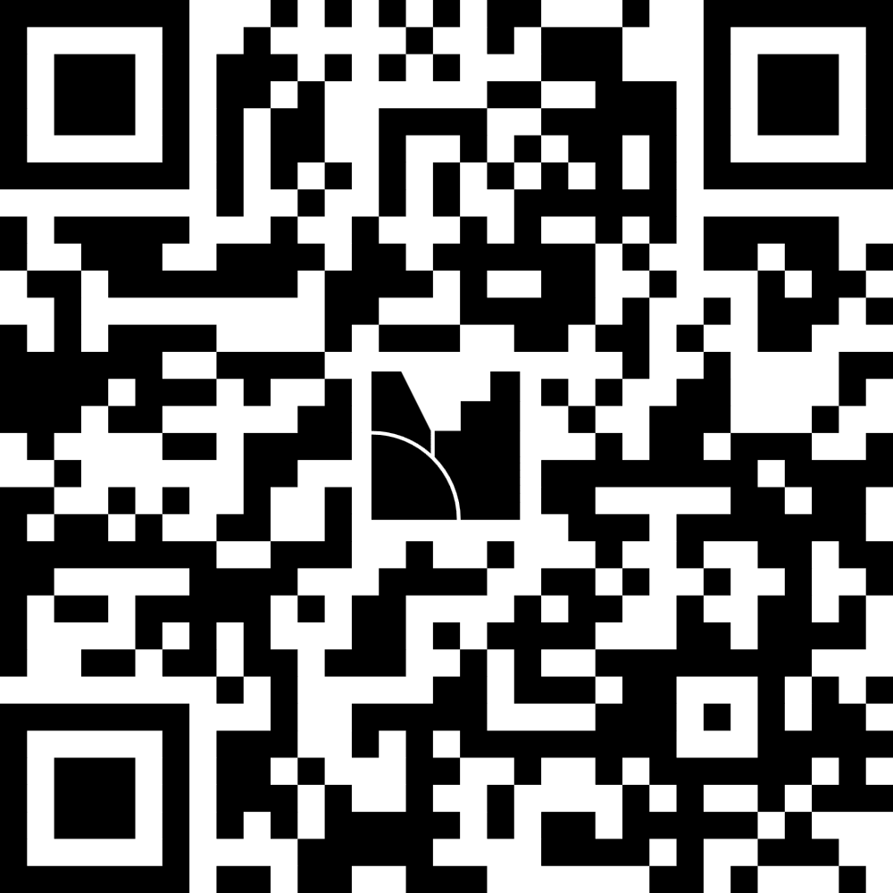
Q & A

