Slide 1



School of Education
PGCE Primary Education – Welcome to our Taster Day
PGCE
Steph Laird
PGCE Primary Programme Leader
Welcome to the University of Roehampton

Slide 2
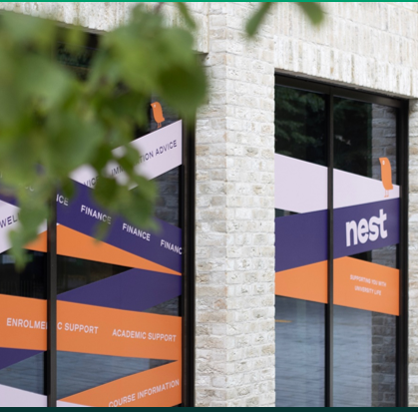
PGCE Primary
Programme Team
Programme Leader: Steph Laird
s.laird@roehampton.ac.uk
Assistant Programme Leader: Pablo Mayorga
Pablo.mayorga@roehampton.ac.uk
Head of Primary ITE: Sarah Leonard
Sarah.leonard@roehampton.ac.uk
Admissions:
Teachertraining@roehampton.ac.uk
Programme Administration:
pgprimary@roehampton.ac.uk
Please check your junk/spam folders as email communication from Roehampton may be in there!
Welcome to the University of Roehampton

Slide 3

PGCE Primary
Overview of the day
9-9.30 - Registration
9.30 – Introduction to the PGCE Primary & Lead Partner/Apprenticeship Primary courses (Steph Laird/Pablo Mayorga)
10.30 – Introduction to Professional Studies (Sarah Leonard)
10.50 – Introduction to English (Steph Laird)
11.10 - Break
11.40 – Introduction to Maths (Lorraine Hartley)
12.00 – Introduction to Science (Nikki Treby & Vanessa Matthews)
12.20 – Final questions
12.30 – Campus services - Disabilities and wellbeing/DBS
~ Optional campus tours available ~
Welcome to the University of Roehampton

Slide 4
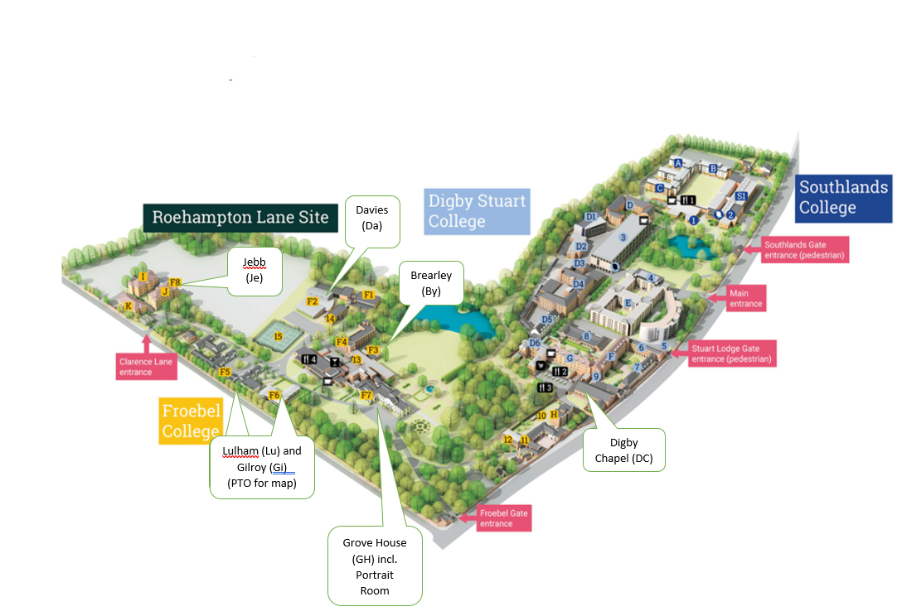
Campus map
PGCE Primary
Welcome to the University of Roehampton

Slide 5
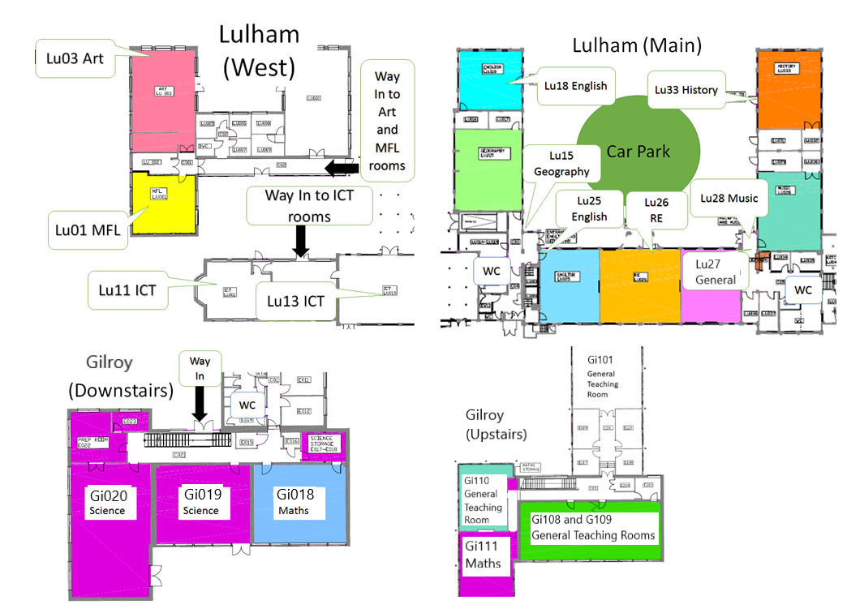
PGCE Primary
Campus map – teaching rooms
Welcome to the University of Roehampton

Slide 6

PGCE Primary
Aims of the sessions:
To introduce you to key people;​
To share information about the course structure and how to prepare for the start of the course;​
To find out about the Professional Studies and Core subject modules;​
To have the opportunity to pose any questions you may have.​
Welcome to the University of Roehampton

Slide 7
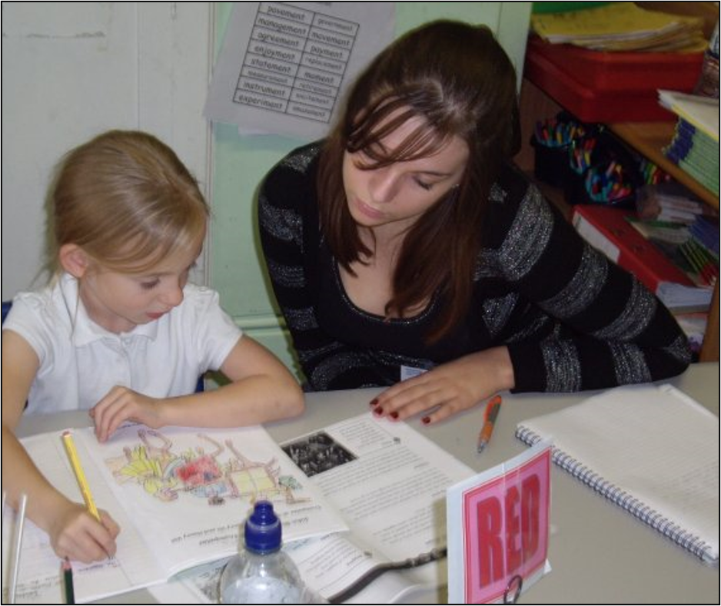
PGCE Primary
A day in the life of a primary school teacher...
Talk to the person next to you:
What is their name?
Why do they want to become a teacher?
Find out an interesting fact about them!
Welcome to the University of Roehampton
Notes:
https://vm.tiktok.com/ZNdfbBKDF/

Slide 8
We value a Froebelian approach to teacher education with whole child development at the core of our philosophy.
Respectful: We respect each other and build positive relationships with our pupils and colleagues. We celebrate diversity and create an inclusive community.
Reflective: We reflect on our practice, connecting academic literature, research, and school experience. We strive to continually improve our pedagogy.
Resilient: We support each other and seek to grow from our challenges. We strive to realise our potential and to thrive together.
Resourceful: We work hard, and we are creative, imaginative, and curious. We keep learning.
The 4 Rs
Welcome to the University of Roehampton

Slide 9
Our Ambition is to:
Prepare our students for their early career induction; to inspire them to continue to learn and develop professionally.
Develop subject specific pedagogical content knowledge and an understanding of the what, how and why of teaching in different contexts; meeting the CCF and going beyond it.
Create research-informed curricula that meet the diverse needs of pupils in our partner schools.
Build a network of experts to mentor and support our students in our partner schools.
Assure quality using meticulous processes that support the highest possible standards.
Welcome to the University of Roehampton

Slide 10

We will now separate into talks for PGCE Primary Core and PGCE Lead Partner and Apprenticeship
Routes into teaching
PGCE Primary
PGCE Core
PGCE Lead Partner
PGCE Apprenticeship
Welcome to the University of Roehampton

Slide 11

Who we work with...
PGCE Primary
WLTTA
Teach Wimbledon
Wandle Teaching School Hub
St John Southworth TSH
London South TSH
Dunraven – Sharing Excellence
South East Learning Alliance
PACE
Avenue Primary Academy
PGCE Lead Partn
Welcome to the University of Roehampton

Slide 12

Pre-course Welcome and Information pages
PGCE Primary
https://www.roehampton.ac.uk/applying/offers/ite-at-roehampton/pgce-primary/
Items to read and download:
Things to do in preparation for the course
Pre-course booklet
English grammar audit
maths audit
science audit
Welcome to the University of Roehampton

Slide 13

PGCE Primary
Ensure you read the information for the Lead Partner/Apprentice Primary route.
1 – Complete the subject audits (the subject leads will provide further information).
2 – Read the pre-course booklet and note the key calendar dates (download this).
3 – Engage in some readings from the pre-course booklet to prepare.
4 – Ensure you have met all existing conditions. You will then be sent an online enrolment link over the summer.
5 – Attend the in-person enrolment day on Thursday 28th August. ID has to be shown in person to complete enrolment.
ThePhoto by PhotoAuthor is licensed under CCYYSA.

Slide 14
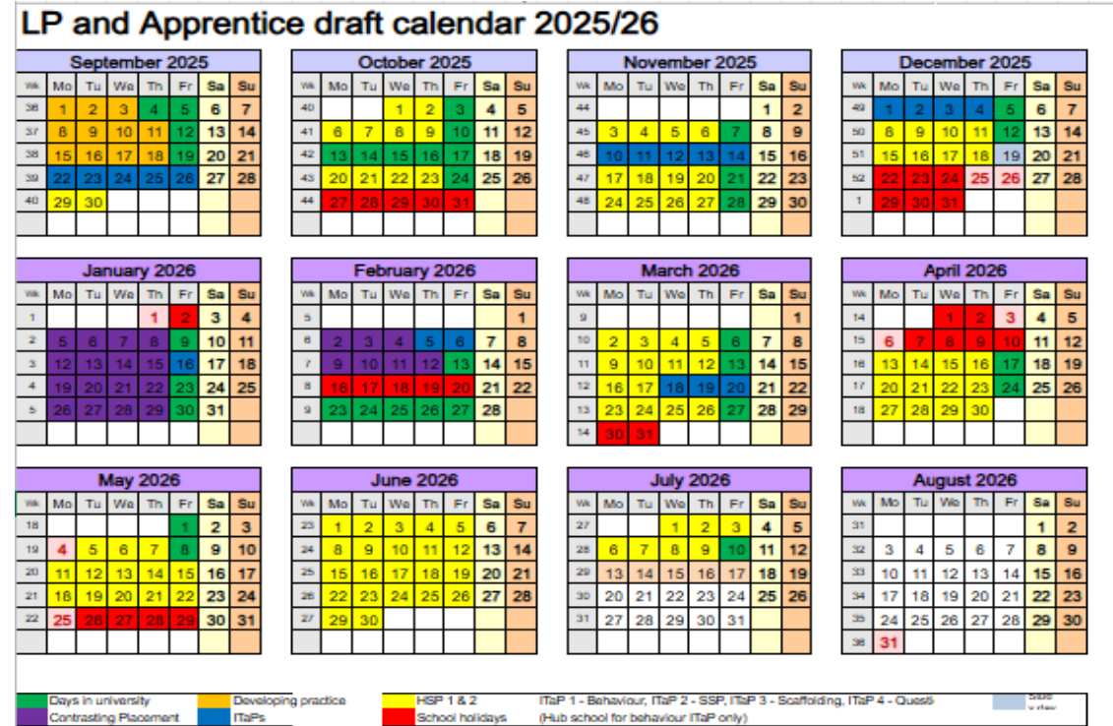
Course calendar in the Lead Partner/Apprentice pre-course booklet
N.B. 100% attendance is expected on the course.
The taught course is 9-3.45/4.45pm every Friday. Note additional weeks. Timetables will be provided at induction on 4th September.

Slide 15
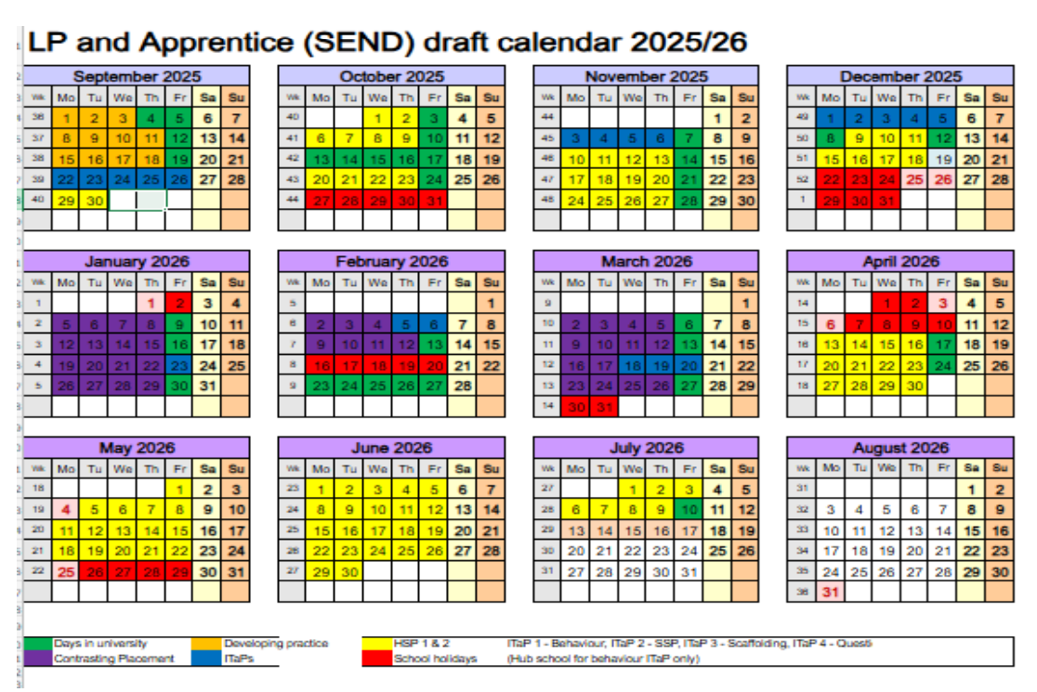
SEND settings – extended contrasting placement in mainstream.

Slide 16
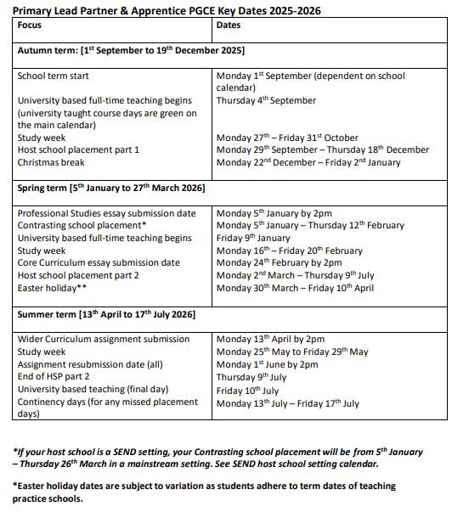

PGCE Primary
Key dates 2025 - 2026
Key dates for the programme are in the Lead Partner/Apprentice pre-course booklet. Note these in a diary!

Slide 17
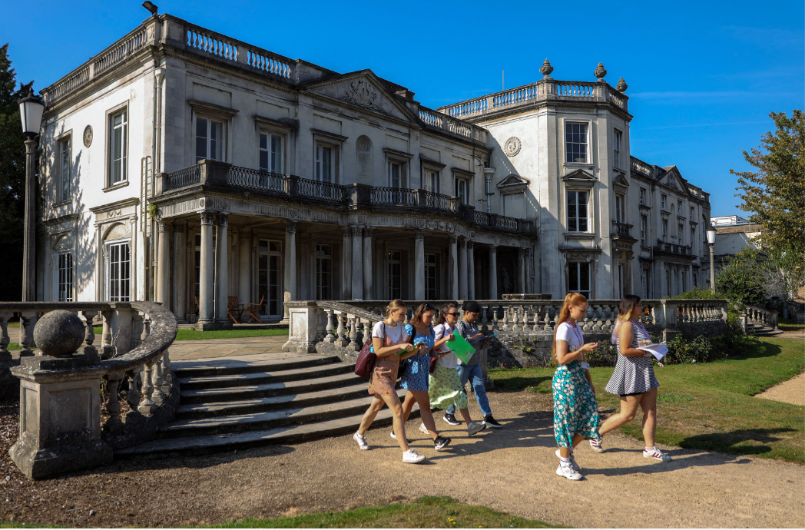
PGCE Primary
What is the PGCE?
Initial Teacher Education programme for primary teachers of children aged 3-11 years.
PGCE (Postgraduate Certificate in Education) with 60 master’s-level credits (Level 7) and awarded Qualified Teacher Status (QTS) or PROGCE (Professional Graduate Certificate in Education) with 60 credits at Level 6 or above and Qualified Teacher Status (QTS).
The programme is a teaching qualification which aims to produce teachers who meet the Teachers’ Standards and also an internationally recognised academic qualification.
Welcome to the University of Roehampton

Slide 18



Academic writing guidance – see the pre-course Welcome Pages – Academic Writing guidance section for self-study materials to prepare.
https://www.roehampton.ac.uk/applying/offers/ite-at-roehampton/academic-writing-guidance/
PGCE Primary
Taught Modules
University Master’s Level Modules
Professional Studies
The Core Curriculum
The Wider Curriculum
Each assignment is 20 master’s level credits
Welcome to the University of Roehampton

Slide 19

PGCE Primary
Assessment
You will be assessed against the Areas of Professional Learning during your school placements in order to meet the Teacher’s Standards at the end of the programme: Professional Behaviours, Curriculum, Pedagogy, Assessment and Managing Behaviour = Qualified Teacher Status (QTS)
You will be assessed on Master’s criteria marking for your assignments – you will receive an assignment booklet at induction.

Slide 20

PGCE Primary
ITaPs - Intensive Training and Practice weeks
All ITT leading to Qualified Teacher Status (QTS) incorporated a new set of Quality Requirement weeks of training in 2024 – 2025.
These four ‘Intensive Training and Practice’ (ITaP) weeks which ‘should focus on specific, foundational, or pivotal areas of the ITT curriculum. It should also demonstrate and build the interplay between evidence-based theory and practice, engaging trainees in critical analysis, application of learning to classroom practice, and focused feedback on such practice,’ (DfE, Initial teacher training (ITT): criteria and supporting advice).
Our ITaPs:
Focus on creating a positive classroom environment, SSP, scaffolding and questioning.

Slide 21

PGCE Primary
Questions...
Useful site for information:
Get Into Teaching -
https://getintoteaching.education.gov.uk/

Slide 22
Campus tours available!

